Slide 1

How (not) to Build a Trusted path in Modern Platforms?
Aritra Dhar
ETH Zurich

Slide 2
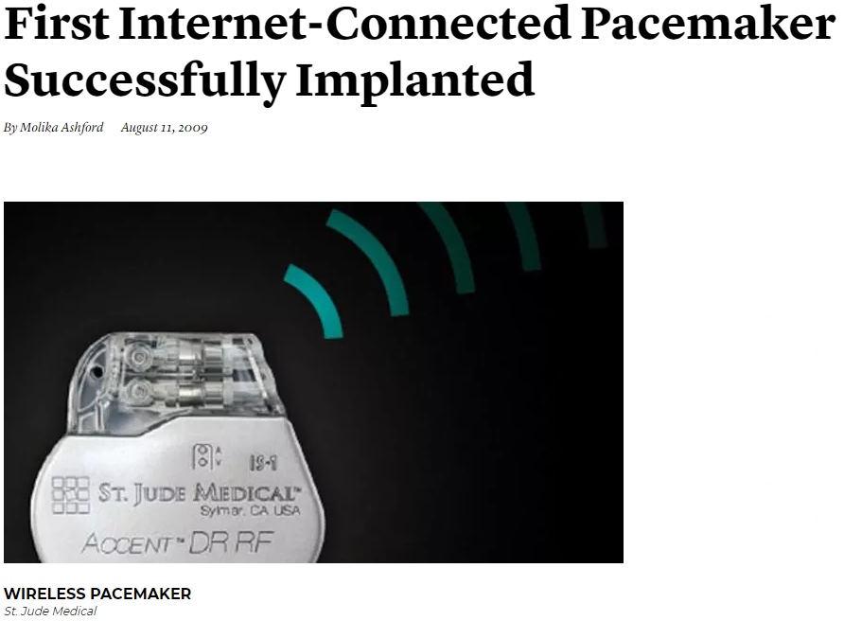
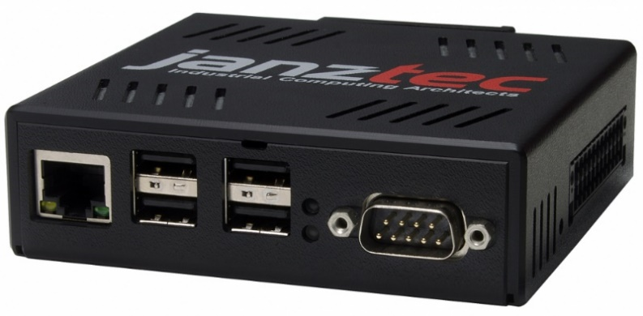
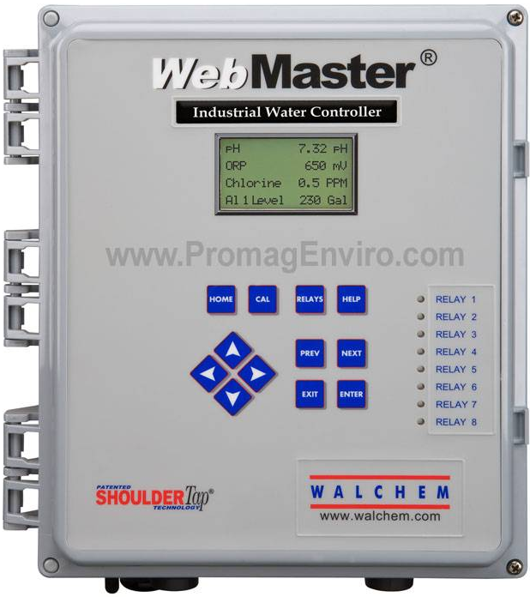
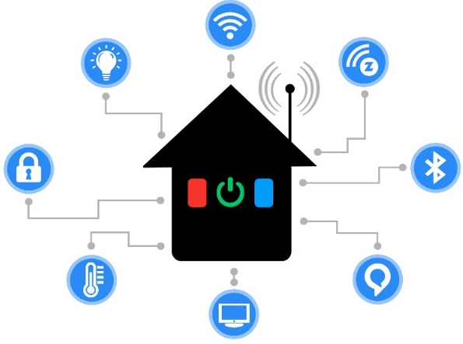
Remote safety/security-critical systems

Slide 3
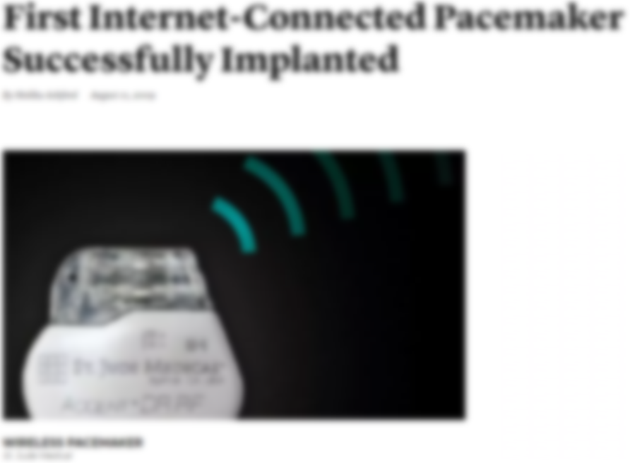
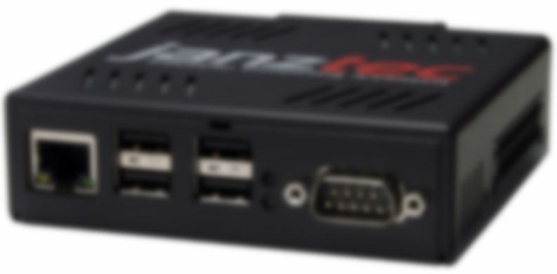
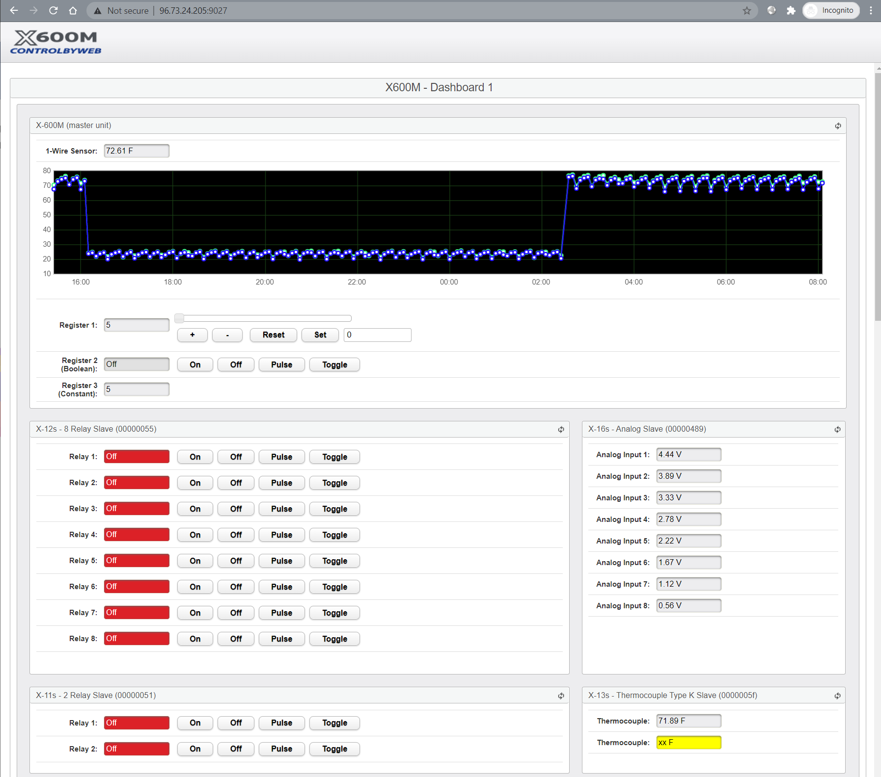
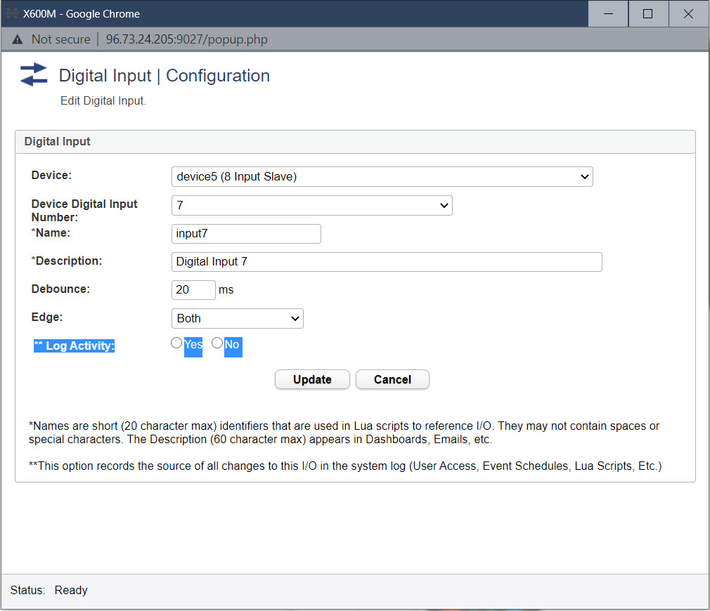


Remote safety/security-critical systems

Slide 4






Large Attack Surface
25.16M
20.92M
2M
36.68M
600K
71K

Slide 5
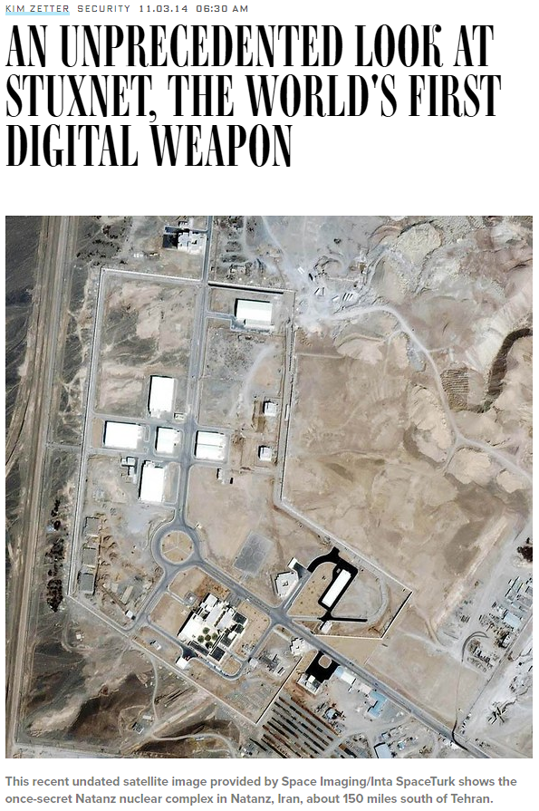
Attacks

Slide 6
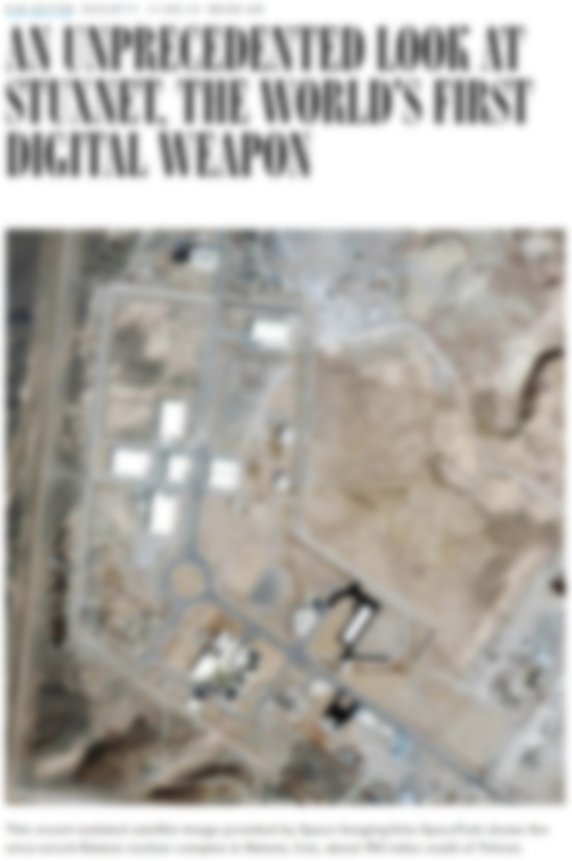
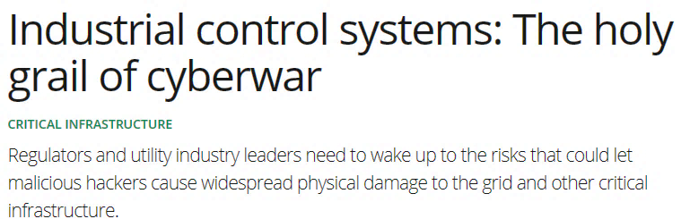
Attacks

Slide 7
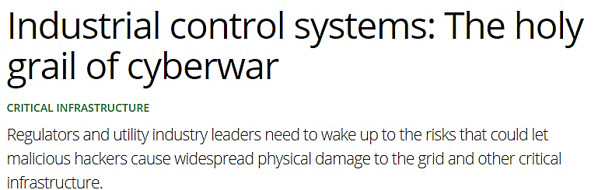
Attacks

Slide 8

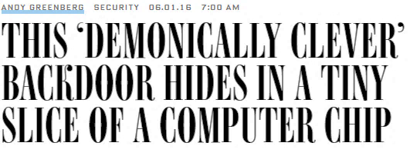
Large Attack Surface

Slide 9
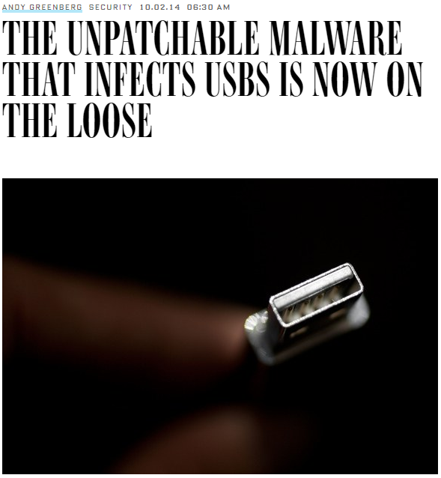
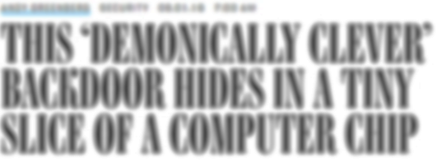
Attacks

Slide 10

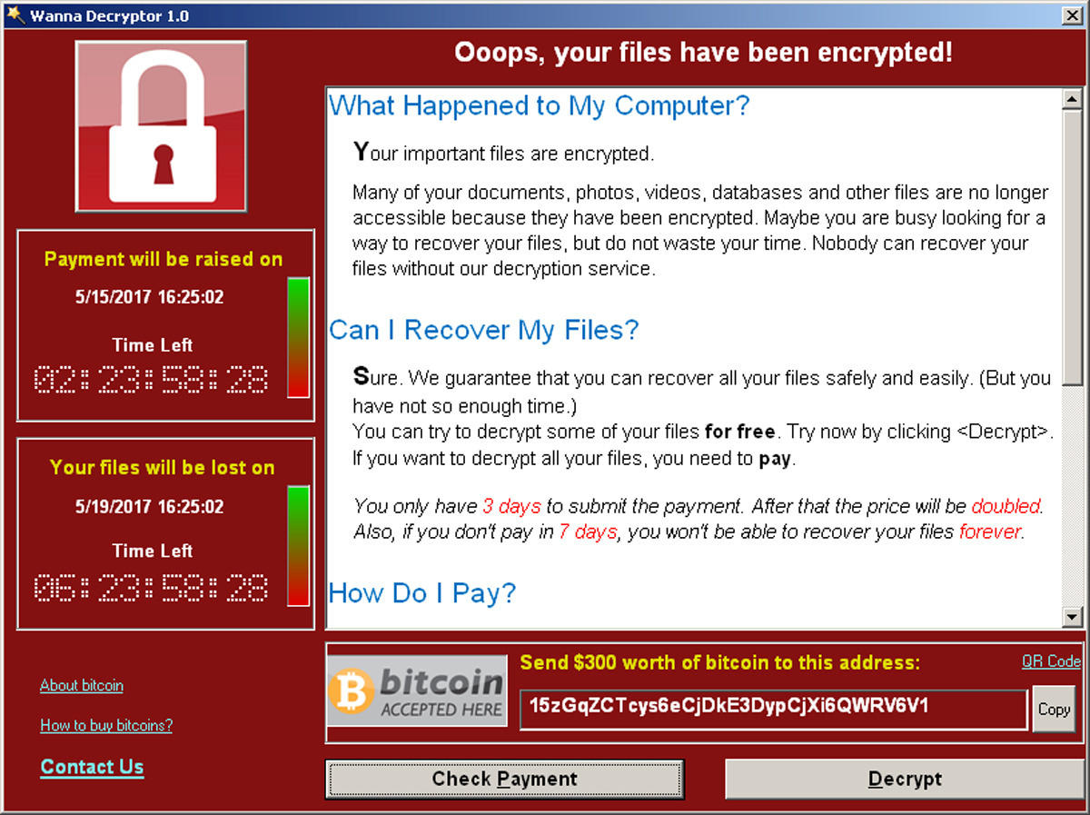
Large Attack Surface

Slide 11



Motivation
Remote device
Heart beat
75
Insulin (U)
177
Basal rate (U/Hr)
0.025
Low limit (mg/dL)
60
High limit (mg/dL)
105
Program
Cancel

Slide 12

Motivation
Remote device
Heart beat
75
Insulin (U)
177
Basal rate (U/Hr)
0.025
Low limit (mg/dL)
60
High limit (mg/dL)
105
Program
Cancel
Aritra Dhar

Slide 13
Motivation
Remote device
Heart beat
75
65
Insulin (U)
177
Basal rate (U/Hr)
0.025
Low limit (mg/dL)
60
High limit (mg/dL)
105
Program
Cancel
Aritra Dhar

Slide 14







Remote Trusted path
User
IO devices
Host
Remote server

Slide 15
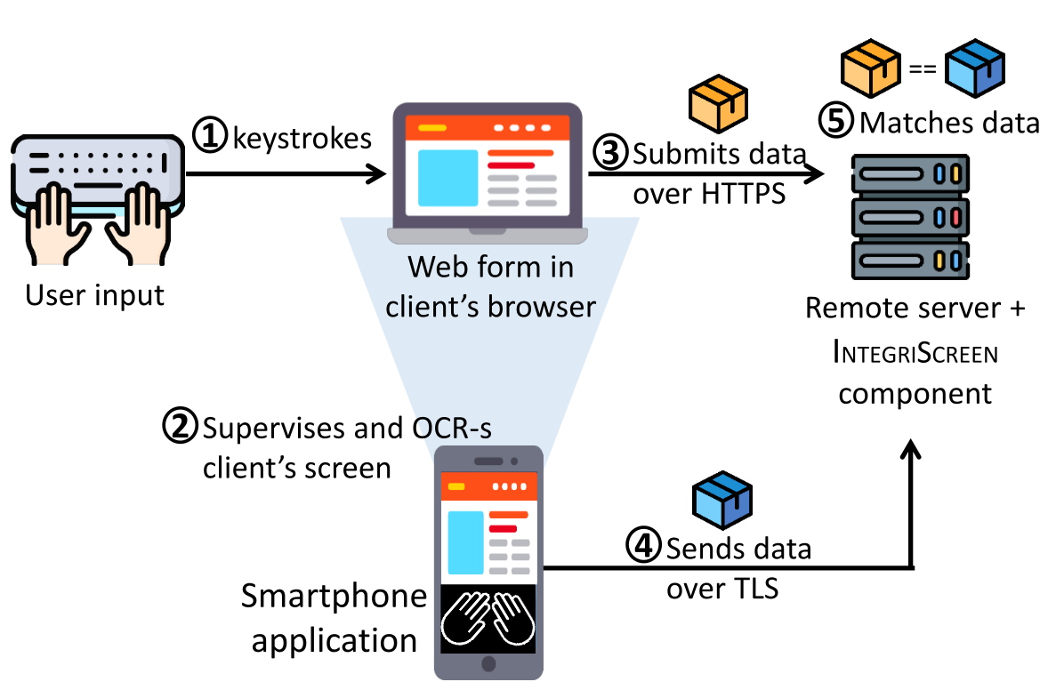
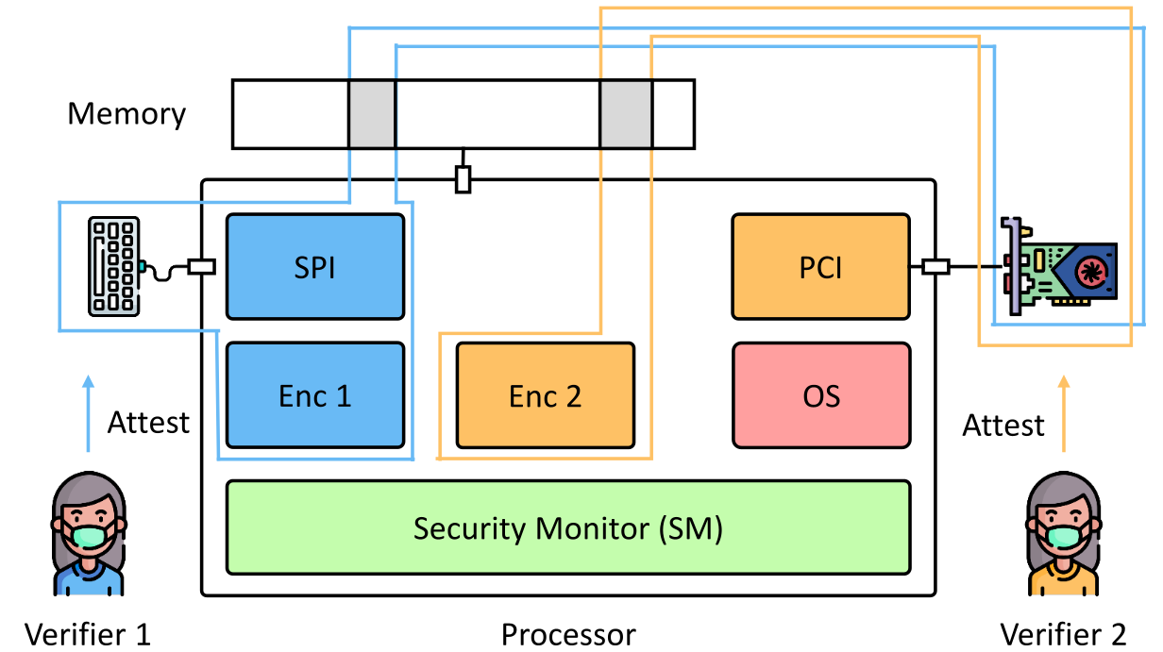
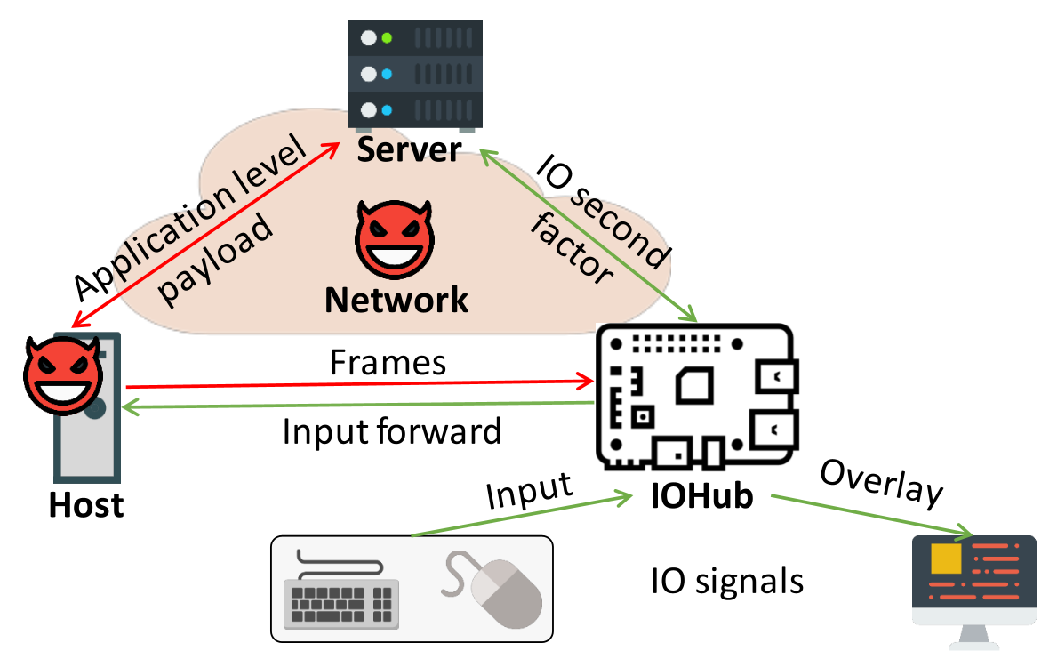
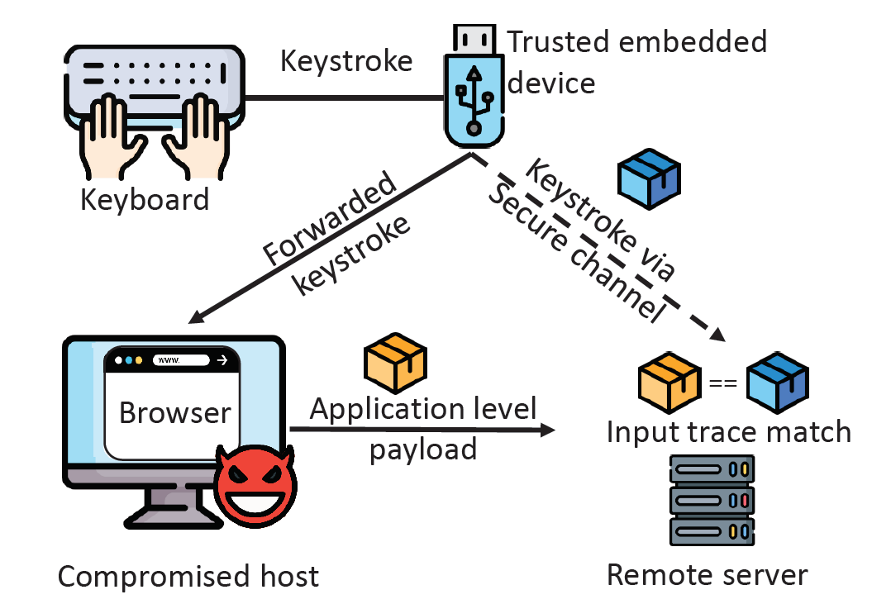
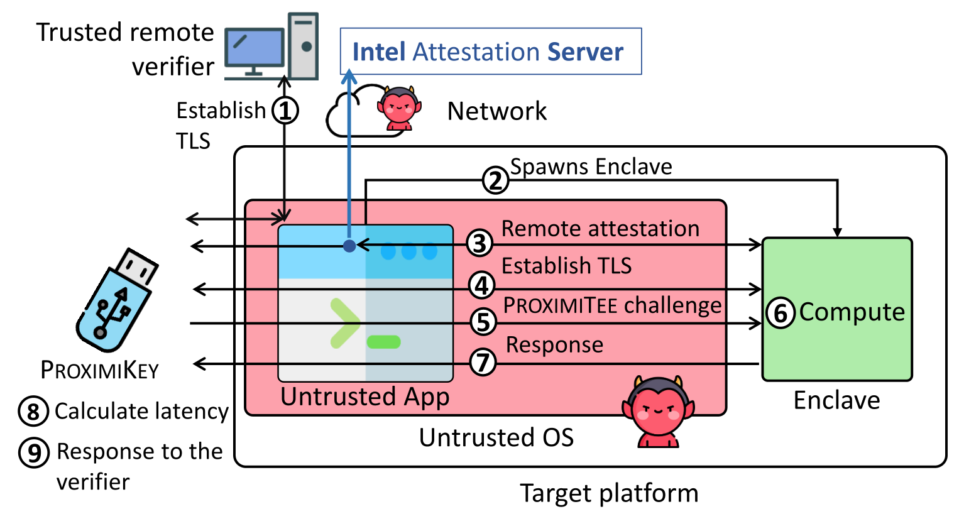
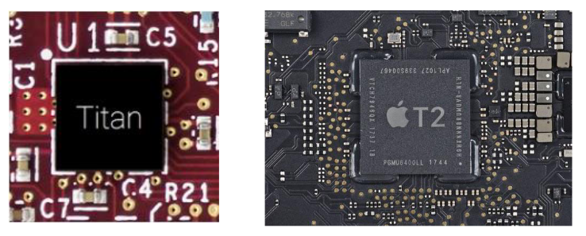
Thesis contribution
Ad-Hoc trusted path solutions
IntegriKey (2017, eprint: 2017/1245)
IntegriScreen (2018, arXiv:2011.13979)
Fundamentals of trusted path
ProtectIOn (NDSS 2020)
Assertion on identity of a platform
ProximiTEE (CODASPY 2020)
External security chips for TEEs
Hardware assisted security (IEEE Security & Privacy 2020)
Reconfigurable HW/SW TCB
PIE (2020, arXiv:2010.10416)
Aritra Dhar

Slide 16
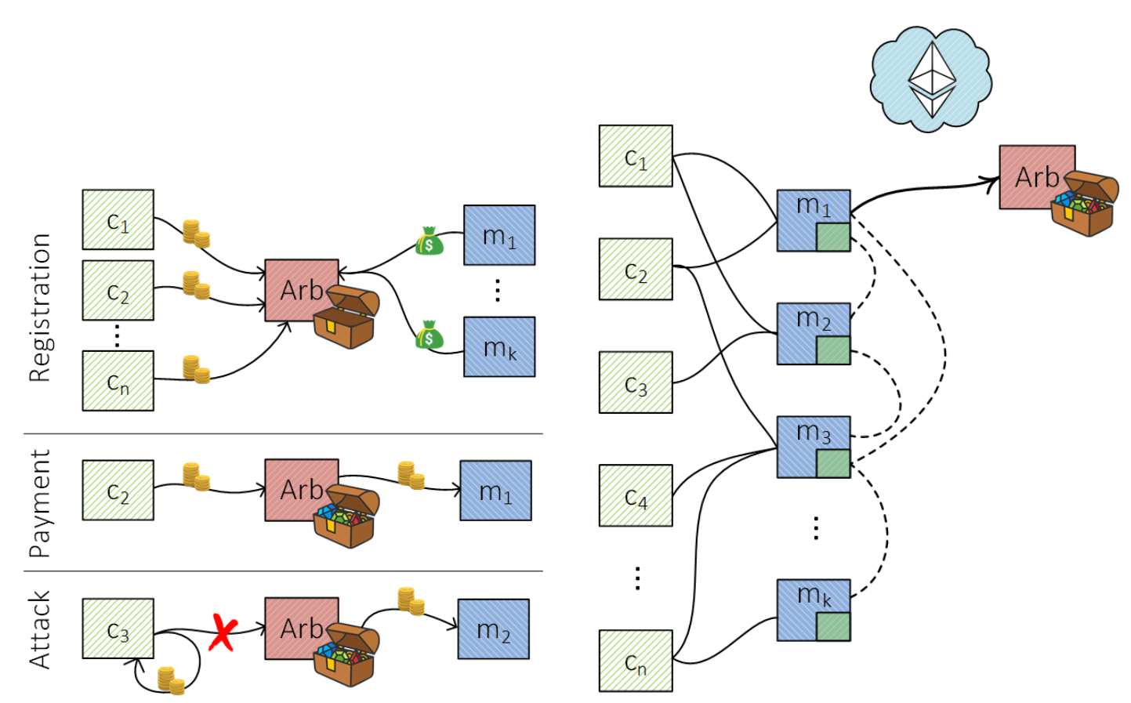
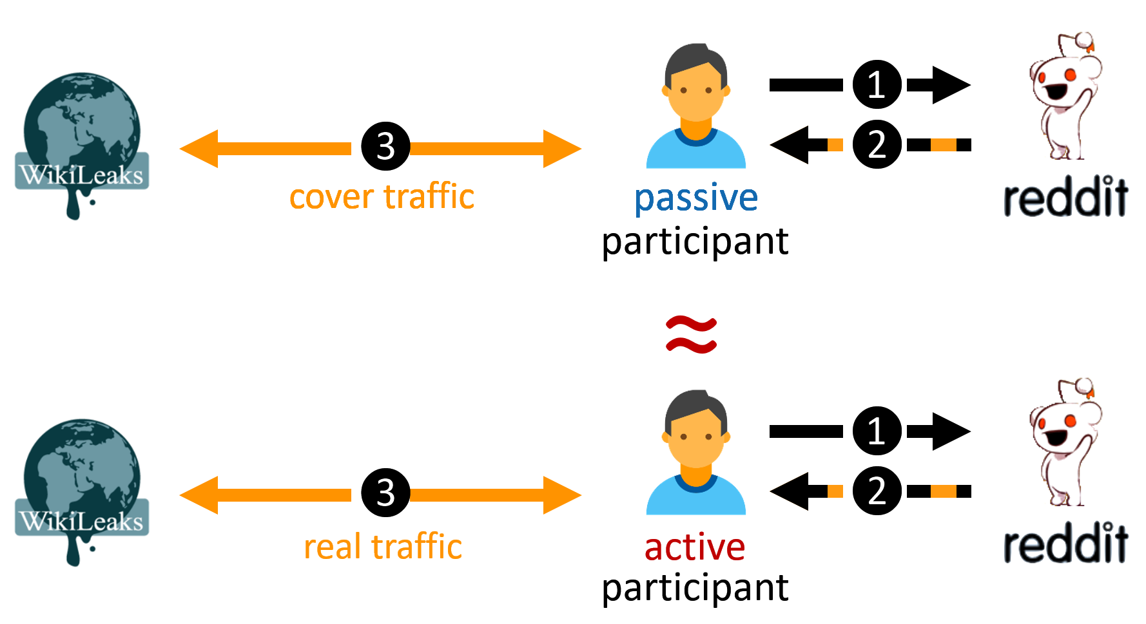
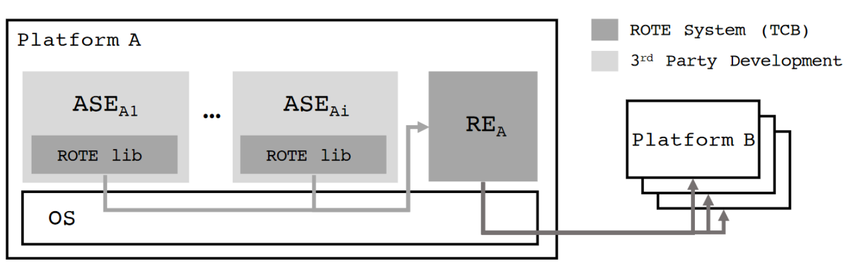
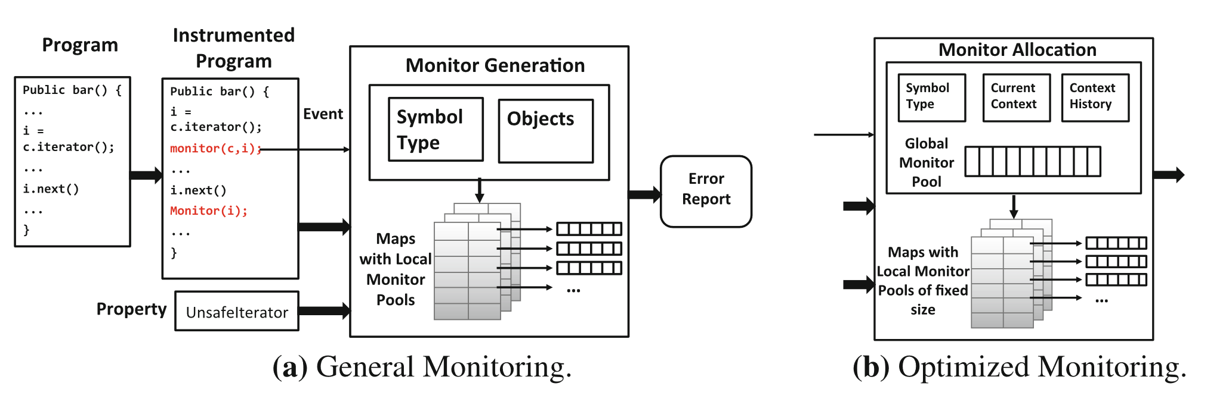
Other contributions
Fast off-chain payments
Snappy (NDSS 2020)
Anonymous communication
CoverUp (NSDI 2019)
Finite state monitoring
Metis (RV 2018)
Rollback protection for SGX
ROTE (USENIX 2017)

Slide 17
Today’s talk
Ad-Hoc trusted path solutions
IntegriKey (2017, eprint: 2017/1245)
IntegriScreen (2018, arXiv:2011.13979)
Fundamentals of trusted path
ProtectIOn (NDSS 2020)
Assertion on identity of a platform
ProximiTEE (CODASPY 2020)
External security chips for TEEs
Hardware assisted security (IEEE Security & Privacy 2020)
Reconfigurable HW/SW TCB
PIE (2020, arXiv:2010.10416)
Aritra Dhar

Slide 18
Today’s talk
Ad-Hoc trusted path solutions
IntegriKey (2017, eprint: 2017/1245)
IntegriScreen (2018, arXiv:2011.13979)
Fundamentals of trusted path
ProtectIOn (NDSS 2020)
Assertion on identity of a platform
ProximiTEE (CODASPY 2020)
External security chips for TEEs
Hardware assisted security (IEEE Security & Privacy 2020)
Reconfigurable HW/SW TCB
PIE (2020, arXiv:2010.10416)

Slide 19
Today’s talk

Slide 20







Solution 1: Transaction Confirmation Device
Remote device
Heart beat
75
Insulin (U)
177
Basal rate (U/Hr)
0.025
Low limit (mg/dL)
60
Android Protected Confirmation
You are going to program
Heart beat 75
Insulin 177U
Basal rate 0.025 U/Hr
Low level 60 mg/dL
High level 105 mg/dL
And more ……
High limit (mg/dL)
105
Program
Cancel

Slide 21



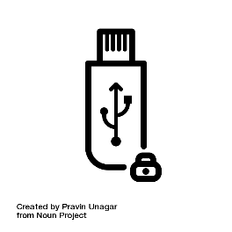
Solution 2: Input Signing
Remote device
Heart beat
75
Insulin (U)
177
Heart beat 75
Insulin 177U
Basal rate 0.025 U/Hr
Low level 60 mg/dL
High level 105 mg/dL
Basal rate (U/Hr)
0.025
Low limit (mg/dL)
60
Trusted embedded device
High limit (mg/dL)
105
Program
Cancel

Slide 22



Display manipulation attack
177
177
Insulin
17
7
1777
Insulin
177
User sees 177
Device records 1777
Host sends 1777
IntegriKey

Slide 23
Observation 1
The lack of output integrity – the render of user inputs on the screen – compromises input integrity.

Slide 24

Solution 3: Overlay
Remote device
Remote device
Heart beat
Heart beat
75
Insulin (U)
Insulin (U)
177
Basal rate (U/Hr)
Basal rate (U/Hr)
0.025
Low limit (mg/dL)
Low limit (mg/dL)
60
High limit (mg/dL)
High limit (mg/dL)
105
Program
Cancel
Program
Cancel

Slide 25
Overlay: Output Manipulation
Remote device
Remote device
Heart beat
Insulin (U)
Insulin (U)
Heart rate
Basal rate (U/Hr)
Basal rate (U/Hr)
Low limit (mg/dL)
Low limit (mg/cc)
High limit (mg/dL)
High limit (mg/cc)
Program
Cancel
Program
Cancel

Slide 26

Overlay: Output Manipulation
Remote device
Insulin (U)
177
Heart rate
75
Basal rate (U/Hr)
0.025
Low limit (mg/cc)
6000
High limit (mg/cc)
10500
Program
Cancel

Slide 27
Observation 2
If the protected output is provided out-of-context,
users are more likely not to verify it.
Therefore input integrity can be violated.

Slide 28
Overlay: Early Form Submission Attack
Remote device
Heart beat
75
Textbox in focus
Insulin (U)
17
Basal rate (U/Hr)
0.025
Fidelius
Trusted overlay from FPGA
Low limit (mg/dL)
60
High limit (mg/dL)
105
OS triggers click
Program
Cancel

Slide 29
Observation 3
If not all the modalities of inputs are secured simultaneously, none of them can be fully secured.

Slide 30






Requirements
The lack of output integrity – the render of user inputs on the screen – compromises input integrity.
Inter-dependency between Input and output

Slide 31
Requirements
If not all the modalities of inputs are secured simultaneously, none of them can be fully secured.
All modalities of input

Slide 32
Requirements
If the protected output is provided out-of-context, users are more likely not to verify it. Therefore input integrity can be violated.
Low cognitive load

Slide 33
Requirements
Low TCB and easy deploy

Slide 34
Requirements

Slide 35








ProtectIOn
Low TCB + fast deployment
Input modalities
IOHub

Slide 36
IO Integrity – Overlay Generation
Remote device
Insulin (U)
Heart rate
Simultaneous IO
Basal rate (U/Hr)
Low limit (mg/cc)
High limit (mg/cc)
Program
Cancel
<form action=“/some_action”, signature = “0x45AB…”, id = “0x0ab”>

Slide 37
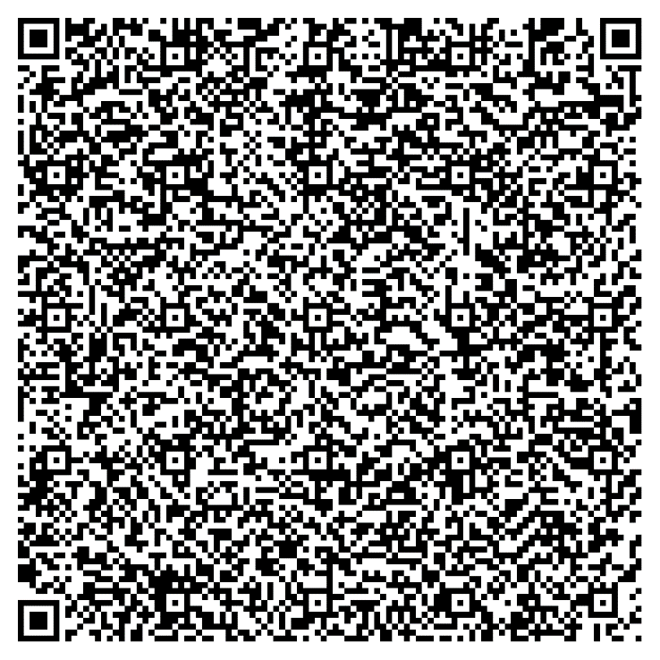

IO Integrity – Overlay Generation
Simultaneous IO

Slide 38
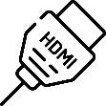

IO Integrity – Overlay Generation
Remote device
Verified UI from secure_site.io
Insulin (U)
Heart rate
Simultaneous IO
Basal rate (U/Hr)
Low limit (mg/cc)
High limit (mg/cc)
Program
Cancel

Slide 39

IO Integrity – Input
Remote device
Verified UI from secure_site.io
Insulin (U)
75
Heart rate
177
Simultaneous IO
Basal rate (U/Hr)
0.025
Low limit (mg/cc)
60
High limit (mg/cc)
105
Program
Cancel

Slide 40
Grabbing User Attention
Output Integrity: Low cognitive load
Several existing mechanisms
Low cognitive load
Put 1 in front of all inputs

Slide 41
Grabbing User Attention
Output Integrity: Low cognitive load
Several existing mechanisms
Lightbox
Low cognitive load
Put 1 in front of all inputs

Slide 42
Grabbing User Attention
Output Integrity: Low cognitive load
Several existing mechanisms
Lightbox
Highlight
Low cognitive load
Put 1 in front of all inputs

Slide 43
Grabbing User Attention
Output Integrity: Low cognitive load
Several existing mechanisms
Lightbox
Highlight
Freezing
Low cognitive load
Put 1 in front of all inputs

Slide 44
Grabbing User Attention
Output Integrity: Low cognitive load
Several existing mechanisms
Lightbox
Highlight
Freezing
Combination
Low cognitive load
Put 1 in front of all inputs

Slide 45
Grabbing User Attention
Output Integrity: Low cognitive load
Several existing mechanisms
Lightbox
Highlight
Freezing
Combination
How to determine when to engage?
Track pointer
Mouse movement on the overlay
Low cognitive load

Slide 46
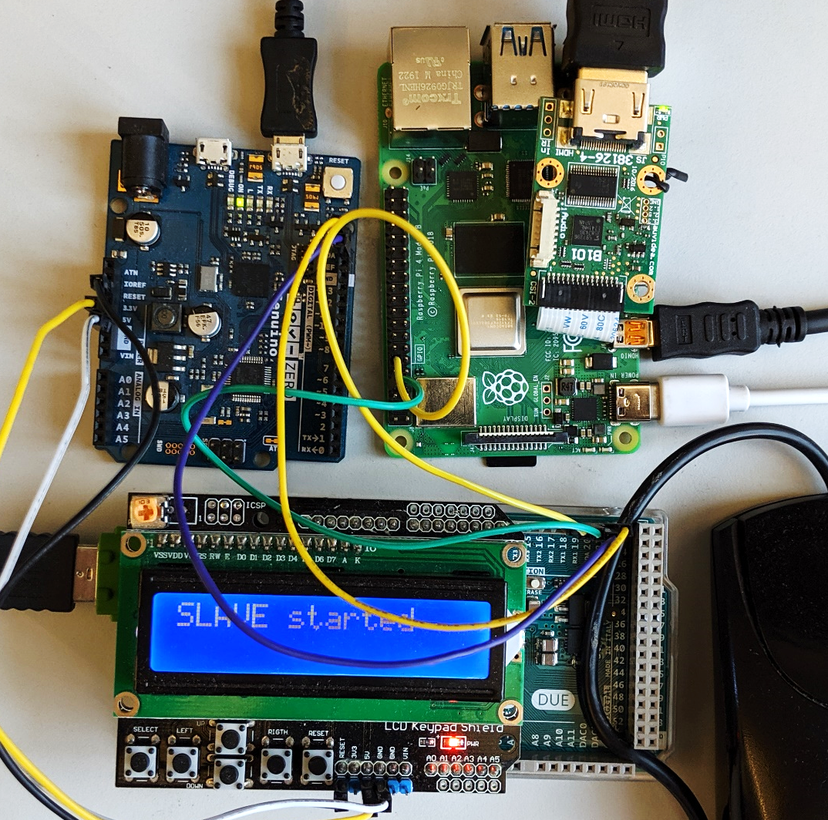

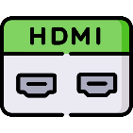







Prototype and TCB
Low TCB
Fast deployment
25.16M
20.92M
1.9K
2M
3.5K
71K
893
600K
121K
36.68M

Slide 47

Performance
Display latency: 21.67 ms
~46 fps
Mouse latency: 250 $μs$
Keyboard latency: 170 $μs$
Pointer detection accuracy: 0.997

Slide 48
Summary
Existing research
Drawbacks
Observations
Requirements for Trusted Path
ProtectIOn design
Prototype

Slide 49


Thank you! Questions?

